Slide 1
Baseline Project Cost

Slide 2














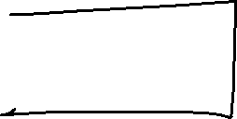











Slide 3
















Slide 4


















Slide 5
Earned Value Analysis

Slide 6
Learning Objectives
What is Earned Value
How to Calculate the Earned Value Manually
How to Calculate the Earned Value using Microsoft Project

Slide 7
Earned Value Management
The most basic cost control technique is to develop a project budget and then track spending against it.
Project cost and schedule performance should be managed as integrated elements and not as separate entities.
If your budget spend plan shows you overspending and your schedule shows milestones slipping, you can know you will be in trouble, but you will have no way of making a quantitative assessment of how bad the trouble is.
The Earned Value Management System solves this problem by providing an accurate picture of spending and accomplishments related to baseline plan. This enables the project manager to quickly form conclusions about the project team’s staffing levels and productivity, as well as providing insight into areas of the WBS where the problems are occurring.

Slide 8
Earned Value Management
Compares 3 pieces of information:
  How much work you planned to have accomplished by now (in money or time terms) called the planned value (PV). Also known as BCWS (Budgeted Cost of Work Scheduled).
  How much you have actually spent (in money or time terms) , called actual cost (AC). Also known as ACWP (Actual Cost of Work Performed).
  The value, in terms of your baseline budget, of the work accomplished by now (in money or time terms), called the earned value (EV). Also known as BCWP (Budgeted Cost of Work Performed).

Slide 9
Earned Value
Money
Budget ceiling
Management
Reserve
Spend Plan
Actuals
Time

Slide 10
Earned Value
NB: Earned value analysis is always specific to a status date you choose. You may select the current date, a date in the past, or a date in the future. Most of the time, you'll set the status date to the date you last updated project progress.
For example, if the current day is Tuesday, 9/12, but the project was last updated with progress on Friday, 9/8, you'd set the status date to Friday, 9/8.
Microsoft Project can be used to calculate these values. However, manual calculations can also be performed.

Slide 11
Example: Detailed Task List
 | Task Name | Duration | Start Date | End Date | Predecessors | Resources | Output
1 | System Design | 8 days | 2009/03/30 08:00 | 2009/04/08 17:00
2 | Define work process | 2.5 days | 2009/03/30 08:00 | 2009/04/01 12:00 |  | system engineer,user | document describing work process
3 | Identify required information and resources | 1.25 days | 2009/04/01 08:00 | 2009/04/02 10:00 | 2 | system engineer,user | list of required information sources
4 | Design software system to support work process | 3 days | 2009/04/02 08:00 | 2009/04/06 17:00
5 | Basic software | 3 days | 2009/04/02 08:00 | 2009/04/06 17:00 | 3 | system engineer | document describing system
6 | Data access required | 1.38 days | 2009/04/02 08:00 | 2009/04/03 11:00 | 3 | system engineer,user | list of data access required
7 | Vendor software required | 1.19 days | 2009/04/02 08:00 | 2009/04/03 09:30 | 3 | system engineer,user | list of software required
8 | Identify required hardware components | 2 days | 2009/04/07 08:00 | 2009/04/08 17:00 | 5,6,7 | system engineer,user | document formally identifying components
9 | System Design Milestone | 0 days | 2009/04/08 17:00 | 2009/04/08 17:00 | 8
10 | Hardware and Software Acquisition | 19 days | 2009/04/09 08:00 | 2009/05/05 17:00
11 | Obtain quotations from hardware vendors | 2 days | 2009/04/09 08:00 | 2009/04/10 17:00 | 9 | hardware acquisition | list of specifications with prices
12 | Obtain quotations from software vendors | 19 days | 2009/04/09 08:00 | 2009/05/05 17:00
13 | Identify potential software products | 4 days | 2009/04/09 08:00 | 2009/04/14 17:00 | 9 | software acquisition | list of software available with prices
14 | Obtain test copies for user to examine | 10 days | 2009/04/15 08:00 | 2009/04/28 17:00 | 13 | software acquisition | examination copies
15 | User comparison and approval | 5 days | 2009/04/29 08:00 | 2009/05/05 17:00 | 14 | system engineer,user | user approval
16 | Hardware and Software Acquisition Milestone | 0 days | 2009/05/05 17:00 | 2009/05/05 17:00 | 11,15
17 | Installation | 11 days | 2009/05/06 08:00 | 2009/05/20 17:00
18 | Order components | 3 days | 2009/05/06 08:00 | 2009/05/08 17:00 | 16 | software acquisition | purchase orders
19 | Test components for technical functionality | 2 days | 2009/05/11 08:00 | 2009/05/12 17:00 | 18 | system engineer | letters of certification
20 | Assemble system | 1 day | 2009/05/13 08:00 | 2009/05/13 17:00 | 19 | system engineer | functioning system
21 | Train user on software | 2 days | 2009/05/14 08:00 | 2009/05/15 17:00 | 20 | trainer,user | trainer certification
22 | User Test of system | 3 days | 2009/05/18 08:00 | 2009/05/20 17:00 | 21 | system engineer,user | user signed approval
23 | Installation Milestone | 0 days | 2009/05/20 17:00 | 2009/05/20 17:00 | 22

Slide 12
Example: Resources
 | Resource Name | Type | Material Label | Initials | Group | Max. Units | Std. Rate | Ovt. Rate | Cost/Use | Accrue At | Base Calendar | Code
1 | system engineer | Work |  | s |  | 100% | R 20.00/hr | R 30.00/hr | R 0.00 | Prorated | Standard
2 | user | Work |  | u |  | 100% | R 10.00/hr | R 15.00/hr | R 0.00 | Prorated | Standard
3 | hardware acquisition | Work |  | h |  | 100% | R 5.00/hr | R 7.50/hr | R 0.00 | Prorated | Standard
4 | software acquisition | Work |  | s |  | 100% | R 5.00/hr | R 7.50/hr | R 0.00 | Prorated | Standard
5 | trainer | Work |  | t |  | 100% | R 25.00/hr | R 37.50/hr | R 0.00 | Prorated | Standard

Slide 13
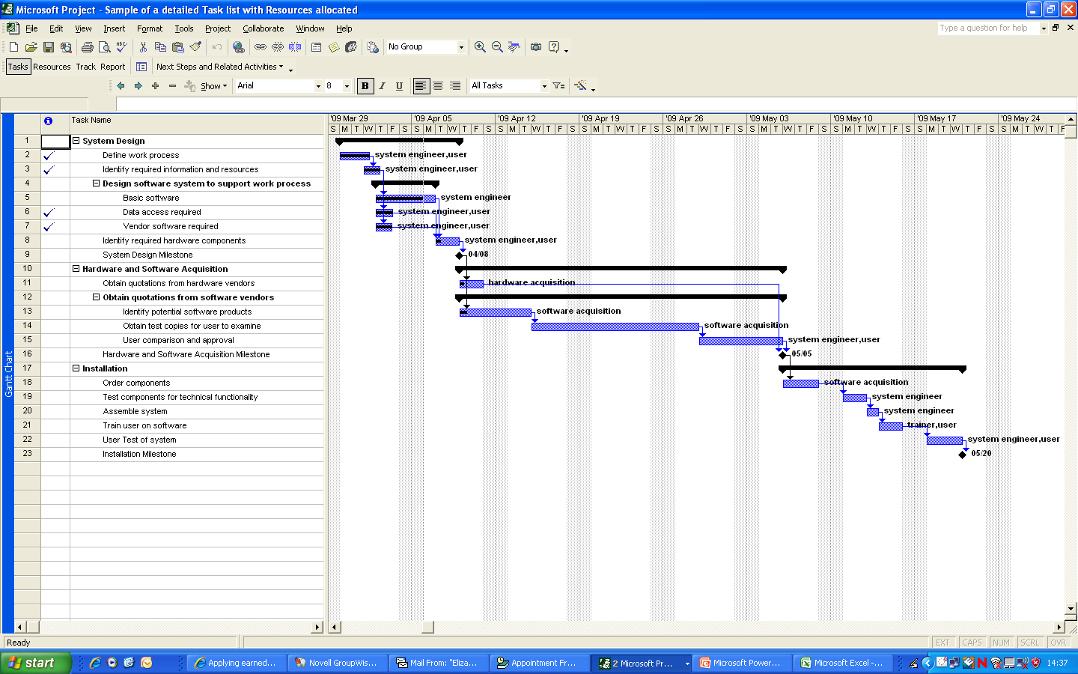
Example: Gantt Chart in MS-Project

Slide 14
Example: Reports
Look at different Views
Look at predefined reports
Define custom reports

Slide 15
Glossary
BCWS – Budgeted Cost of Work Scheduled
ACWP – Actual Cost of Work Performed
BCWP – Budgeted Cost of Work Performed
  If BCWP is greater than BCWS, the task / project is ahead of schedule.
  If BCWP is less than BCWS, the task / project is behind schedule.
  If BCWP is greater than ACWP, the task / project is under budget.
  If BCWP is less than ACWP, the task / project is overspending

Slide 16

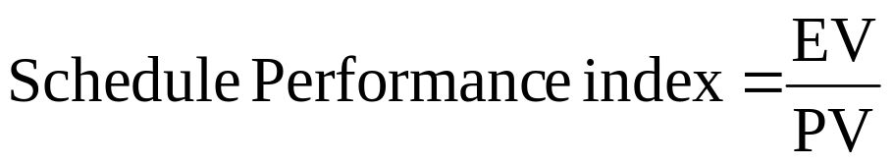
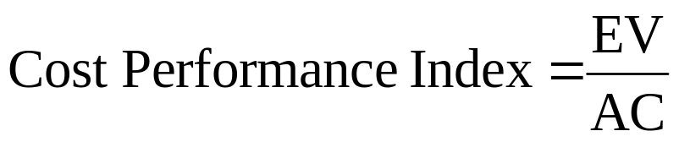
Indicators
Any ratio > 1 is favourable, < 1 is unfavourable
When behind schedule (slippage), schedule variance often turns into cost variance, especially if there is pressure to achieve the original goal.

